Slide 1
Meeting Notes 17.09.

Slide 2
Optimization Pipeline
Optimize J = q + λ_len·n + λ_time·t
Searchspace:
  phi_model: ucb, eid, mass, niveau
  Param: kappa,w,tau
  svgd_iters
  debt_weight
Used TPE (Tree-structured Parzen Estimator) with Optuna library
  Bayes search, devide good and bad samples, create a density around them, calculate expected improvement and sample again
  Reduces search space in comparison to combinatorial optimization by

Slide 3
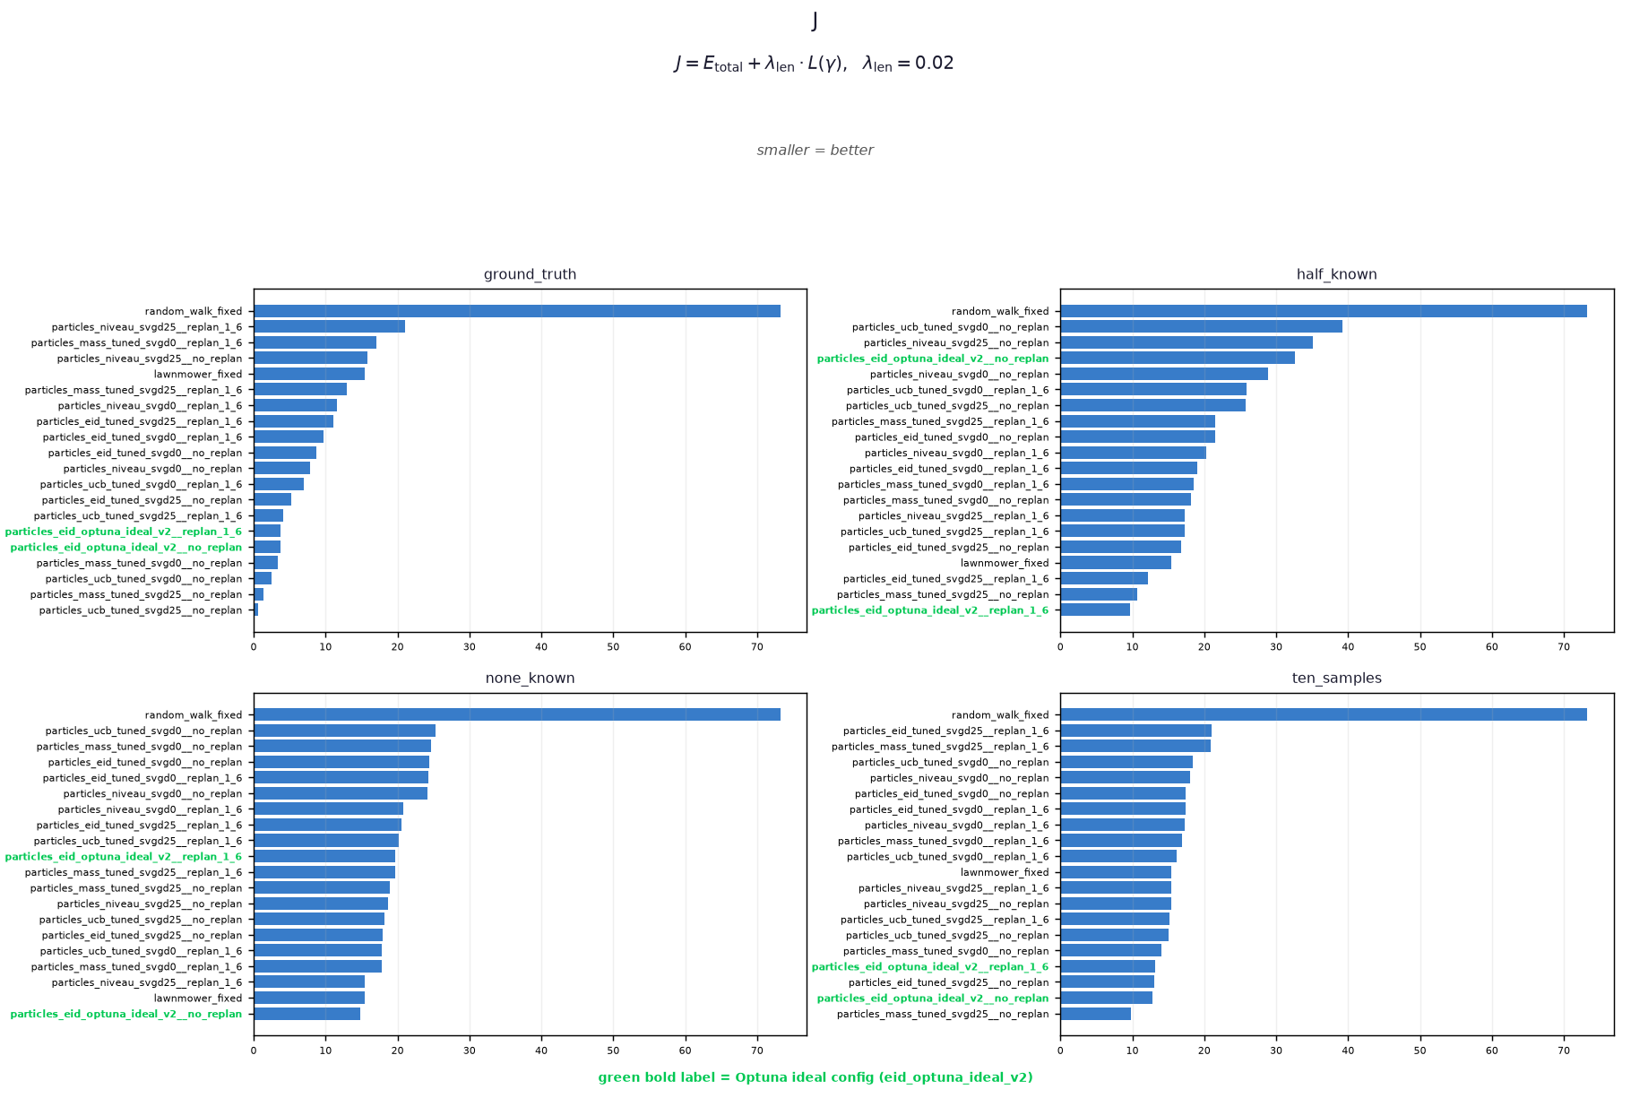
Evaluation pipeline results

Slide 4
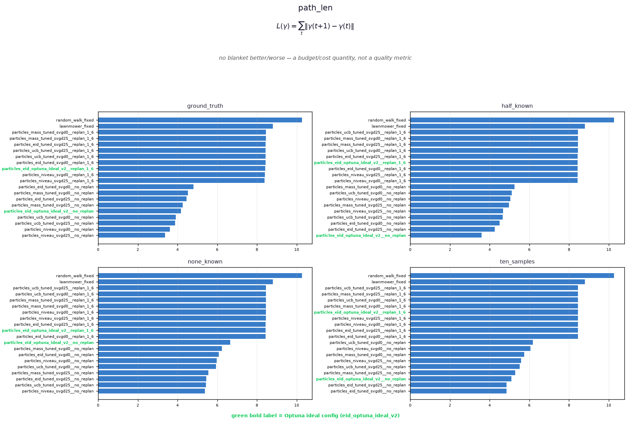
Evaluation pipeline

Slide 5
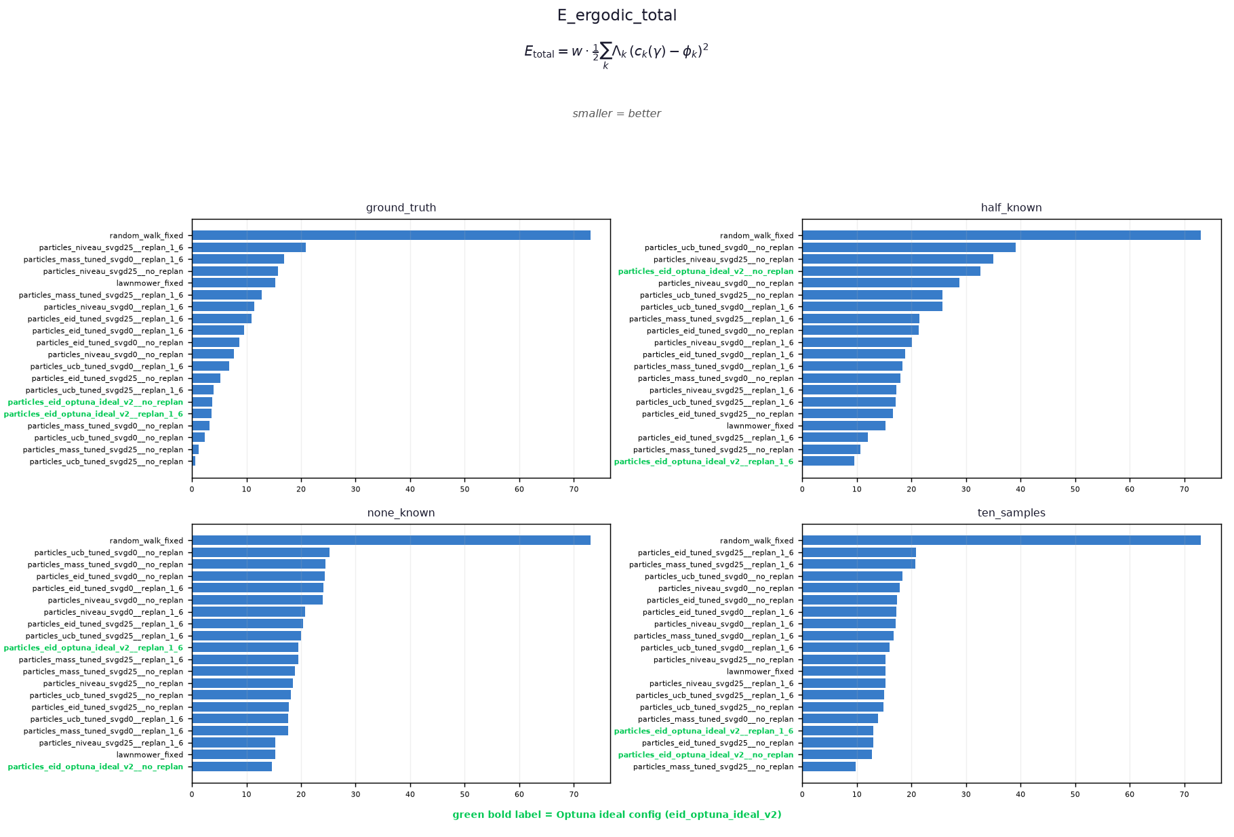
Evaluation pipeline

Slide 6
Conclusion
Optuna found results do seem to provide good results
Very dependent on the setting
Setting dependent configuration would be great
  Further improve learning based configuration settings
  For now: MLP with two hidden layers – supervised learning with candidates evaluated and labeled during the optimization
  Next step: inlcude J as unsupervised metric

Slide 7
3D Results
Finished training on 200 different shapes (natural shapes e.g. different prisms, 3D letter versions, stanford library)
Enhanced with se3 allginment contraint during inference

Slide 8
Thought looking foreward
Real Robot tests?
Prepare a testing setup
3D robot arm trajectory constraints (constraints not just on surface) are so far not considered. Considering them would need a planning in joint space
Improve MLP configuration prediction

